Slide 1

UAV Planning, Autonomous Tracking, and Obstacle Identification and Avoidance
Álvaro Melgosa Pascual
1
Notes:
UAV=Unmanned Aerial Vehicle

Slide 2

Motivation
Notes:
First of all, why am I doing this?
What is the purpose of this Thesis?

Slide 3
Motivation
Safety
Notes:
Most important issue in aerospace industry
UAVs can be considered part of aerospace industry, but not so safe
Disembarking the human eliminates intuitive sensing (inertial, visual, noise…)
Sensing has to be done by sensors and interpreted by computers for safe autonomous flight

Slide 4
Safety
Motivation
Improved
OCAS
Notes:
OCAS (similarly to TCAS in commercial aircraft) tries to eliminate the posibility of a physical collision of the UAV with its surroundings
OCAS operates as intermediate functional layer between operator and UAV

Slide 5
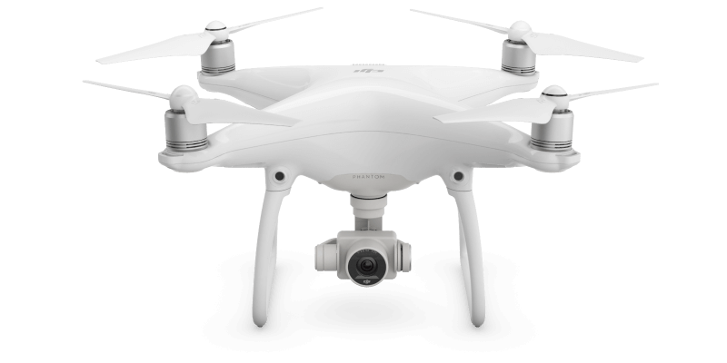
Example: DJI Phantom 4
Motivation
Source: dji.com
Notes:
Why is it important to have a reliable Obstacle Collision Avoidance System?
DJI recently (March 2016) built one into their Phantom 4
Based on stereoscopic cameras

Slide 6
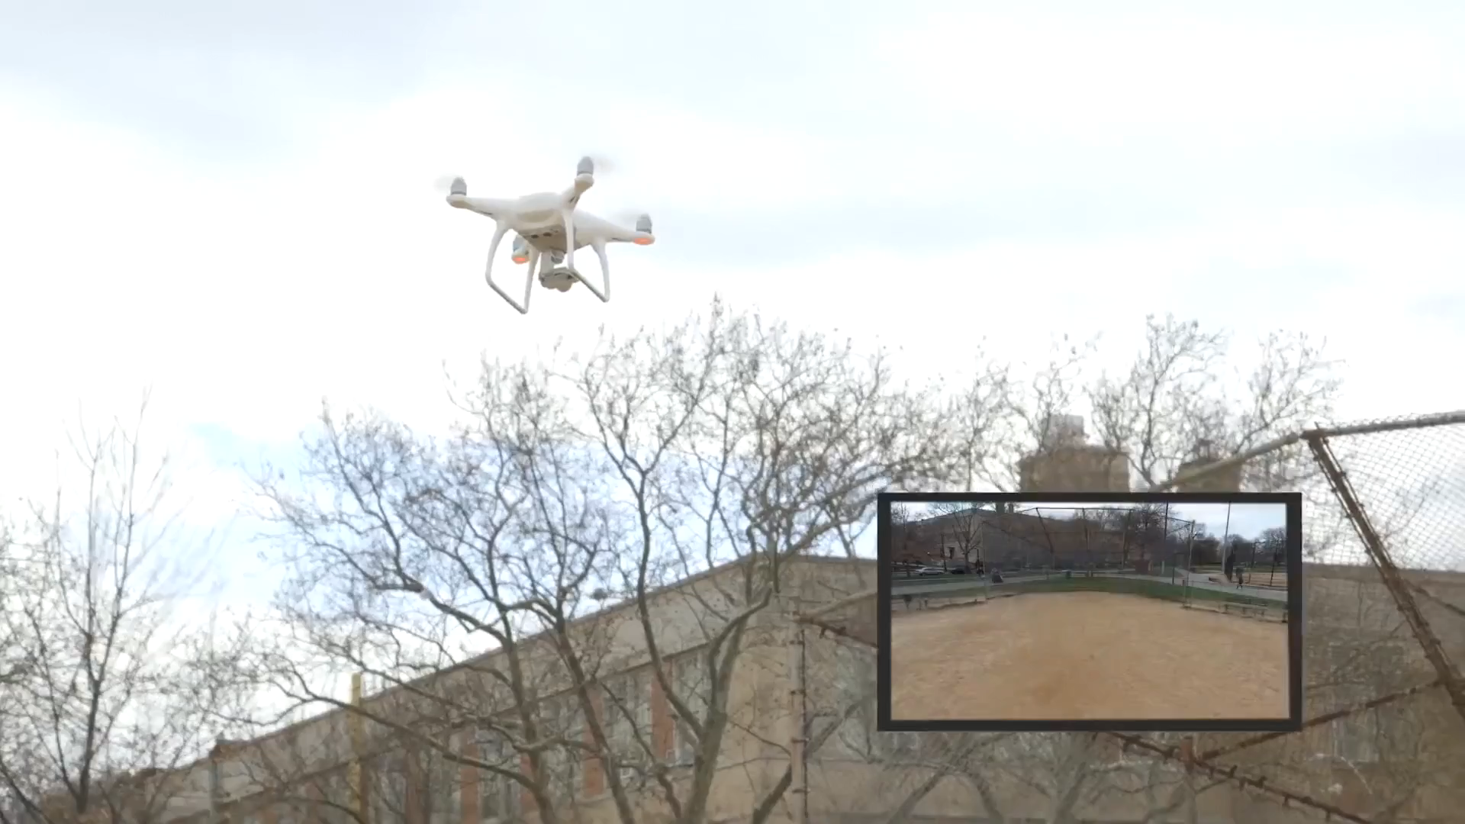
Regular operation
Motivation
Source: gizmodo.com
Notes:
Gizmodo journalists were testing the new features of the UAV
In particular the Emergency mode, that stops the vehicle when a collision is about to happen

Slide 7
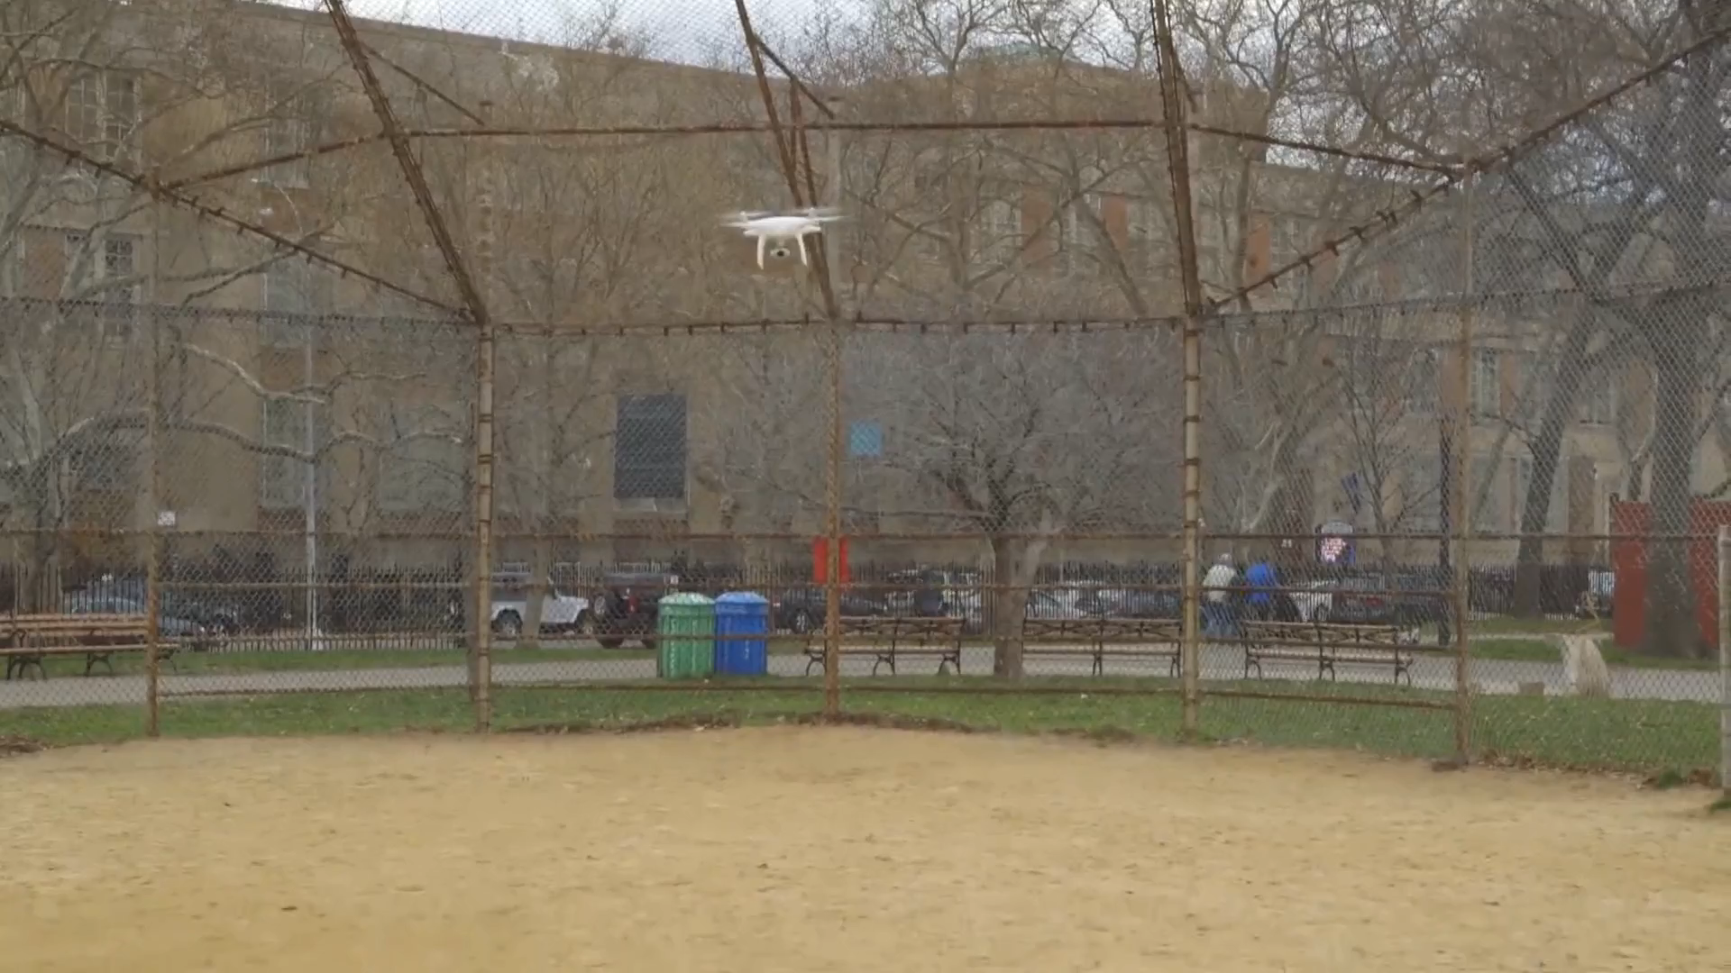
Faulty operation
Motivation
Source: gizmodo.com
Notes:
However, there are sometimes (Sport mode) that the Emergency mode is deactivated
The journalist was relying on that safety system while testing other features, and accidentally crashed the UAV

Slide 8
Objectives
Motivation
Design an OCAS
Integrate is within existing UAVs
Build a working prototype
Demonstrate that safety is improved

Slide 9
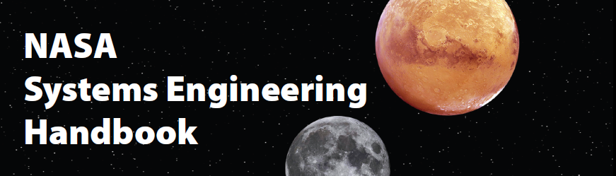
Methodology
Motivation
Systems Engineering collects and organises all the information needed to understand the whole problem, explores it from all angles, and then finds the most appropriate system solution.
Richard Beasley, president of INCOSE UK, 2015
Notes:
Systems Engineering provides a set of tools that facilitate the systematic analysis of the needs of any system
INCOSE = INternational COuncil of Systems Engineering

Slide 10
Result
Motivation
A system that is:
Reliable
Modular
Expandable
Open
Notes:
Result: a system that is reliable, modular, expandable and open
Open is a important property since it allows future research and improvements
It constitutes a base on which technology can be further developed and fitted to any specific need

Slide 11
1.
Design
2.
Implementation
Outline
3.
Testing

Slide 12
Design

Slide 13
Design

Slide 14
Implementation

Slide 15
Implementation

Slide 16
Implementation

Slide 17
Testing

Slide 18
Testing

Slide 19
Testing

Slide 20
Conclusions

Slide 21
Conclusions

Slide 22
Conclusions

